Slide 1

PROJECT PROPOSAL
Global Sports Footwear
Retailer Analytics
Group Members:
Samiksha Singh
Dhruvil Joshi
Sudha Swain
Abhijeet Thorat
ILS-Z511 Database Design (Spring 2026)

Slide 2





PRESENTATION OVERVIEW
Community & Population
01
Sports footwear brands & retailers in the global marketplace
Dataset Overview
02
30,000+ transactions across 6 brands, 5 categories, 6 countries
Problems Addressed
03
Pricing strategy, revenue performance & customer behaviour
Ethics & Privacy
04
Responsible data handling and aggregate-only reporting

Slide 3



01
COMMUNITY & POPULATION
Sports footwear brands and retailers operating in the global marketplace
Sports Footwear Brands
Retailers & Platforms
Nike, Adidas, Puma, Reebok, ASICS, New Balance
Set wholesale pricing & seasonal discount strategies
Monitor product category performance & customer satisfaction
Allocate marketing & production budgets across geographies
Retail chains, independent stores & online platforms
Determine promotional pricing market-by-market
Manage inventory across 5 categories (Running, Training, Basketball, Lifestyle, Gym)
Identify income segments driving revenue per channel
Both groups form a unified community - brand pricing decisions directly constrain and inform retailer decisions.

Slide 4
02
DATASET OVERVIEW
Source: Kaggle - Global Sports Footwear Sales (2018-2026)
30,000+
18
6
6
Transactions
Attributes
Global Brands
Countries
Key Attributes
order_id, order_date
final_price_usd, units_sold
brand, model_name, category
revenue_usd, payment_method
gender, size, color
sales_channel, country
base_price_usd, discount_percent
customer_income_level, customer_rating

Slide 5

02
DATASET AT A GLANCE
Geographic Coverage: USA, UK, Germany, India, UAE, Pakistan | Channels: Online & Retail Store | Income Levels: Low, Medium, High

Slide 6

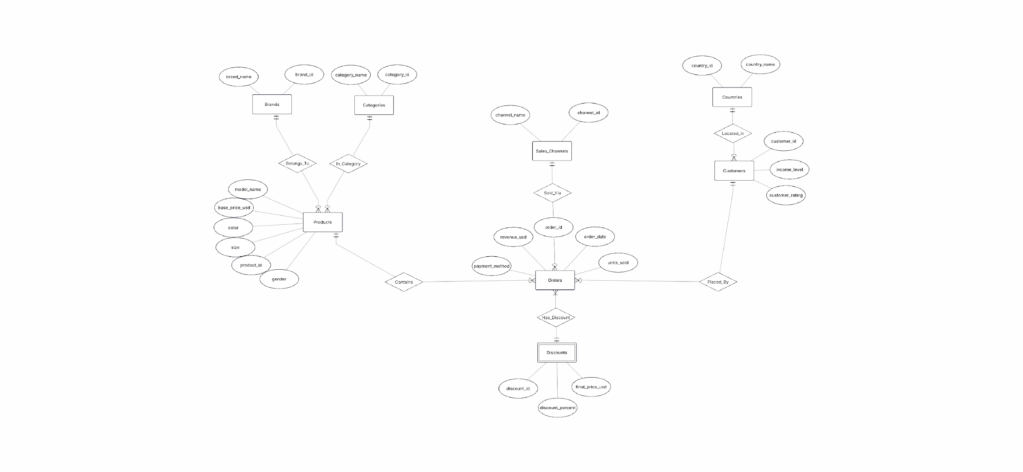
02
CHEN ER DIAGRAM
Entity-Relationship Model for the Global Sports Footwear Retailer Database

Slide 7



03
PROBLEM 1: PRICING STRATEGY
Retailers often apply blanket discount policies without evidence of whether discounts drive incremental revenue or erode margin.
1a
Discount Depth vs. Revenue
1b
Brand Price Sensitivity
Finding the point where discounting helps vs. hurts total revenue.
Which brands need discounts to sell, and which sell well at full price?
1c
Category Discount Effectiveness
1d
Channel-Specific Pricing
Does discounting work equally across Running, Basketball, Lifestyle, Training, Gym?
Should discounts be concentrated online or in-store?

Slide 8



03
PROBLEM 2: CUSTOMER BEHAVIOUR
Helping Retailers & Manufacturers understand Customer Behaviors and optimize their strategy based on analysis
2a
Loyalty Patterns
2b
Satisfaction Drivers
Analyze customer’s loyalty towards brands, and their purchasing decision towards brand regardless of the pricing
Identify which combinations of products which consistently produce high customer satisfaction
2c
Geography & Demand
2d
Payment Method Signals
Understanding where the demand is strongest, which markets to prioritize and what to stock per region
Does how customers pay reveal anything about who they are and how much they spend? Allowing retailers to plan specific offers

Slide 9


04
ETHICS & PRIVACY
While this dataset is synthetic and privacy-safe, its patterns mirror real-world behaviors and must be handled with the same ethical care as actual user data.
Masking Sensitive Attributes
No Personal Recommendations
Income level and customer rating stored in restricted-access tables with role-based controls. Column-level encryption in production.
Outputs inform pricing policy and inventory strategy at the product/market level - no individual consumer targeting.
Aggregate-Only Reporting
Restricted Use Scope
All analyses produce group-level summaries only. No individual transaction data is presented, preventing re-identification.
Findings scoped to pricing strategy and assortment planning. Extensions to personalised pricing or surveillance require separate ethical review.

Slide 10
THANK YOU!
Questions & Feedback

